Slide 1
Java Collection Framework

Slide 2

AGENDA
1
What is collections
2
Hierarchy of collections
3
Interfaces and Classes
4
List, Set and Map

Slide 3

General information about the collections
Collections - storage, supporting a variety of ways of accumulation and ordering of objects in order to allow efficient access to them.
Main operations are supported:
Adding a new item to the collection;
Removing an item from the collection;
Change an item in a collection
Collections include dynamic arrays, linked lists, trees, sets, hash tables, stacks, queues, etc..

Slide 4
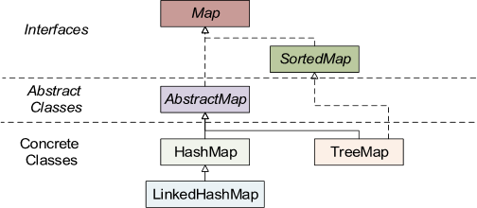
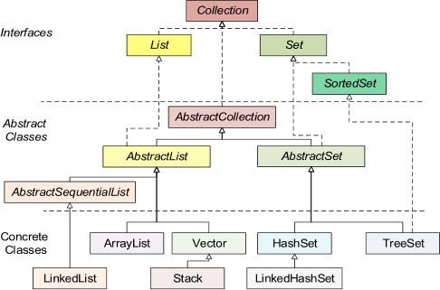
Hierarchy of collections

Slide 5
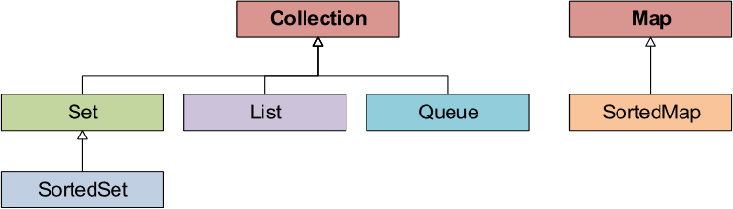
Hierarchy of collections
JDK does not provide direct implementations of the Collection and Map interfaces, but there are many implementations of more specific sub-interfaces :

Slide 6
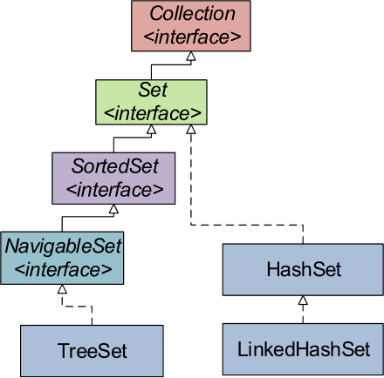
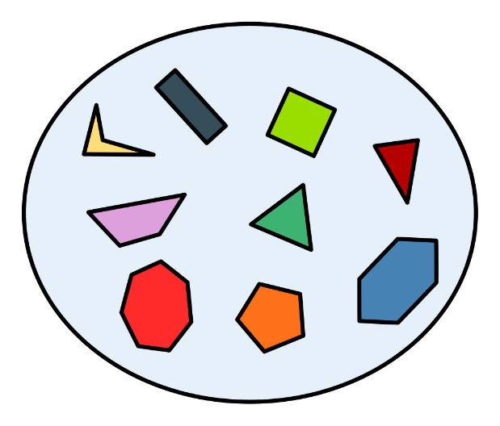
Sets
Set (set) ─ collection without duplicate elements.
A set of polygons

Slide 7
Basic Sets
HashSet – set of unordered elements (the sequence of extraction of elements may not coincide with the sequence of their addition).
LinkedHashSet ─ with preservation of order.
CopyOnWriteArraySet – implementation of the Set interface, which uses the CopyOnWriteArrayList.
Two sets are considered equal if they contain the same elements.
A set of polygons

Slide 8
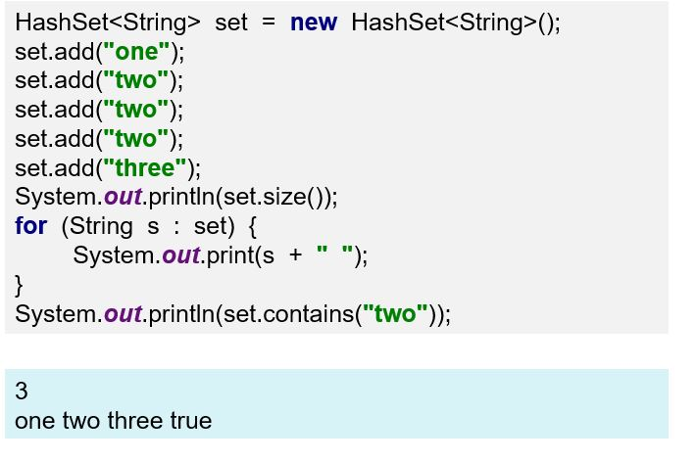
Sets: HashSet

Slide 9
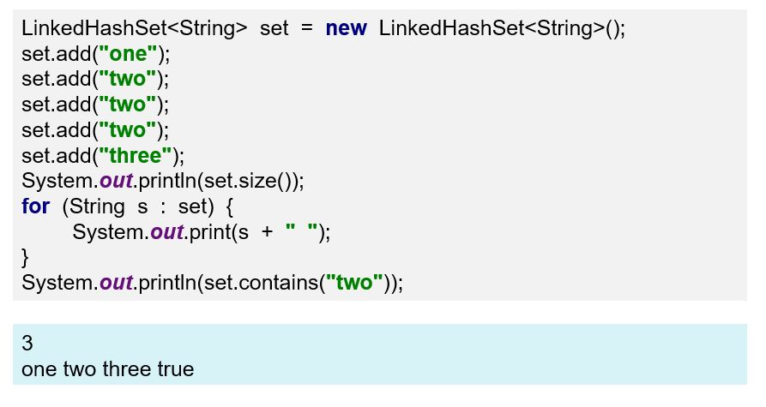
Sets: LinkedHashSet

Slide 10
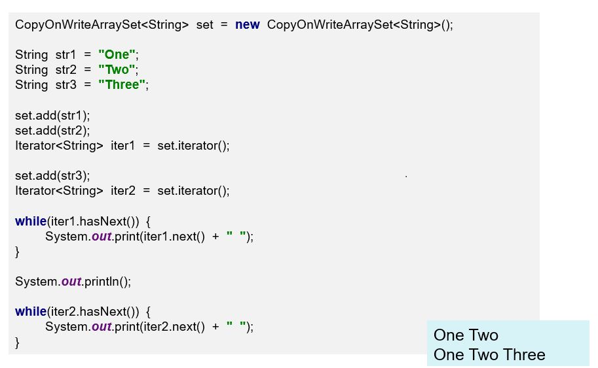
Sets: CopyOnWriteArraySet

Slide 11
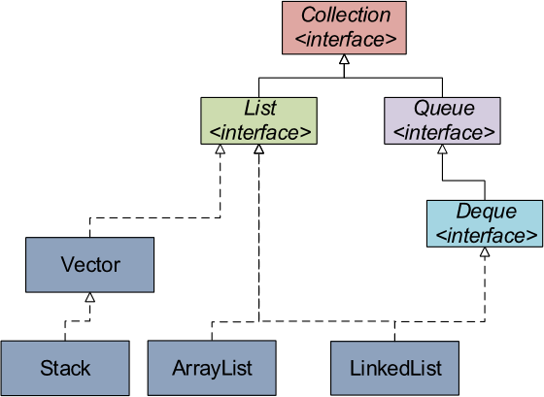
Lists
List is an ordered collection (preserves the sequence of adding elements and allows access to the element by index).
ArrayList ─ Array-based list.
LinkedList ─ Doubly-linked list.
Stack – A list of type last-in-first-out (LIFO).

Slide 12
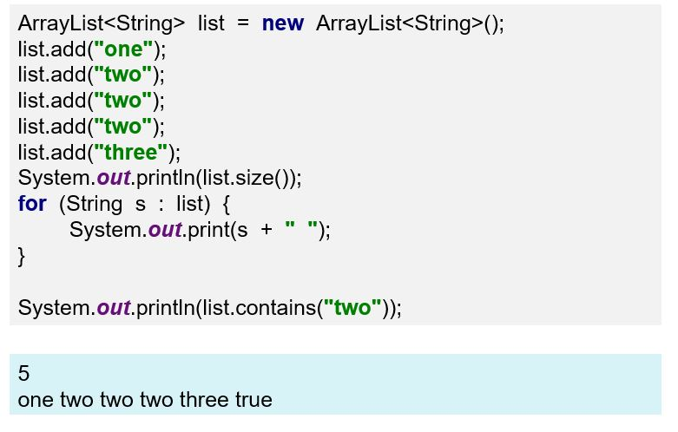
Lists: ArrayList

Slide 13
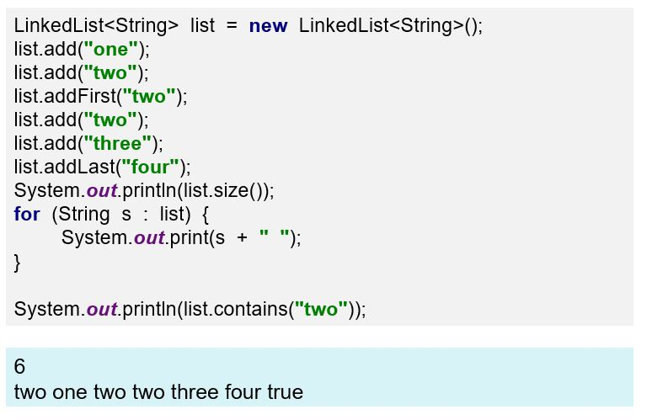
Lists: LinkedList

Slide 14
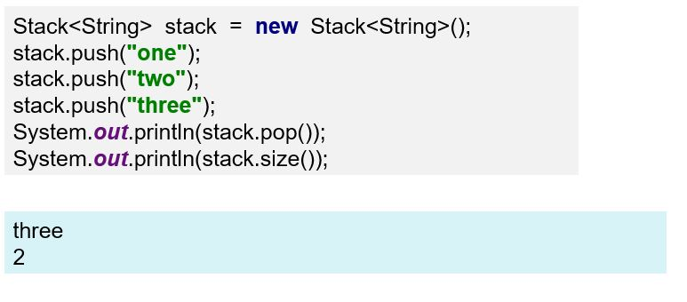
Lists: Stack

Slide 15
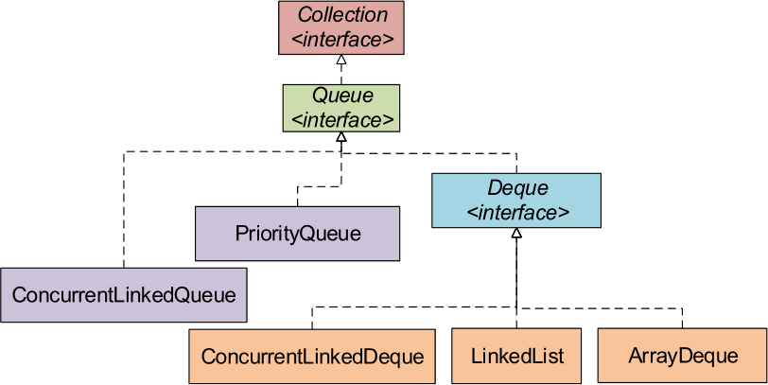
Queues
Queue is an ordered collection of the first-in-first-out (FIFO) type.
PriorityQueue – queue based on sorting of elements.
ConcurrentLinkedQueue – “classic" (without internal
reorganization) queue, thread-safe.

Slide 16
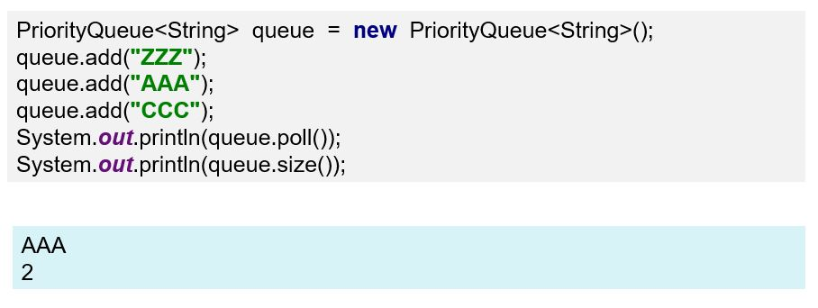
Queues: PriorityQueue

Slide 17
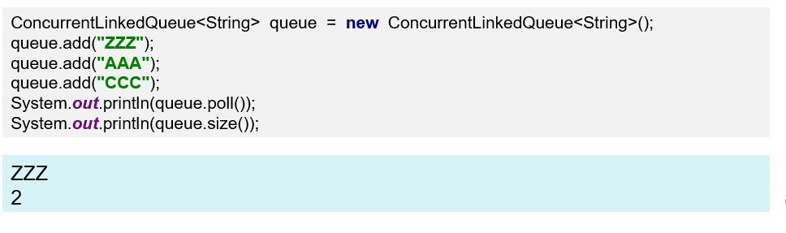
Queues: ConcurrentLinkedQueue

Slide 18
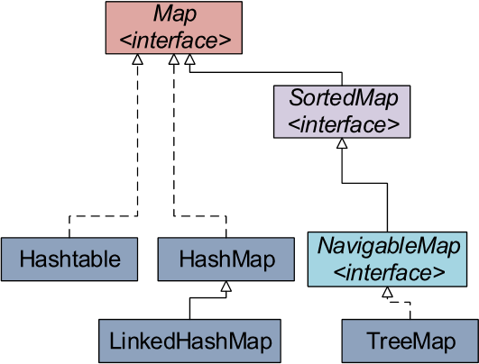
Maps
A map is a collection that works with sets of pairs of key-value objects (in many other programming languages such a structure is called a "dictionary" or an "associative array".
All the keys in the maps are unique. Reusing already existing key value "wipes" an element previously associated with such a key.

Slide 19
Basic Maps
HashMap – unsorted and disordered map.
LinkedHashMap – the order in which the elements are stored is determined by the order in which they are added.
TreeMap – stores items in sorted order.
Hashtable – thread-safe collection (analogous to HashMap), the order of the elements in which it is not defined.

Slide 20
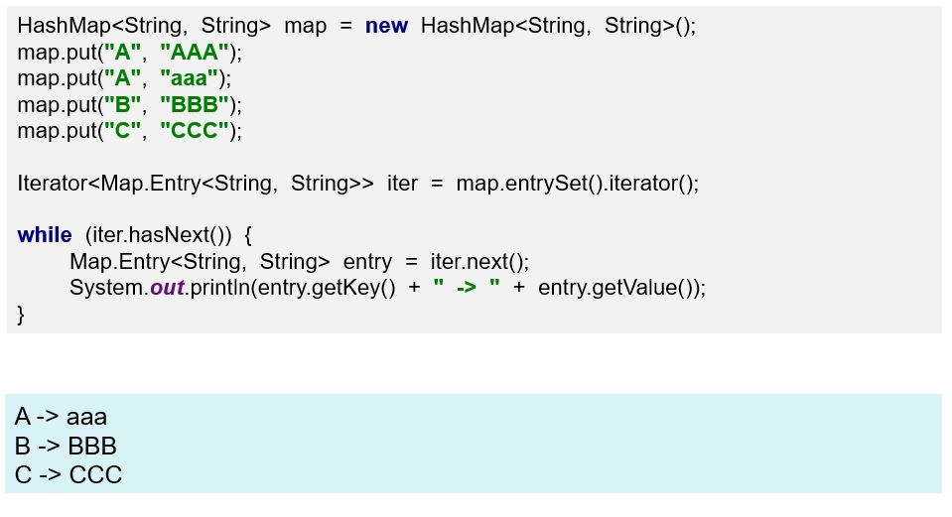
Maps: HashMap

Slide 21
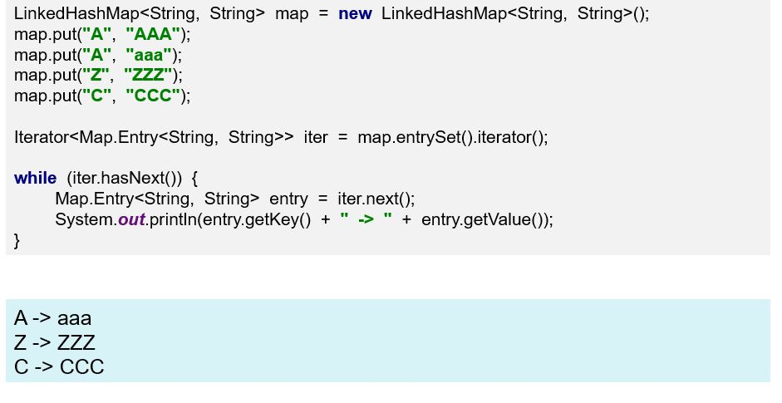
Maps: LinkedHashMap

Slide 22
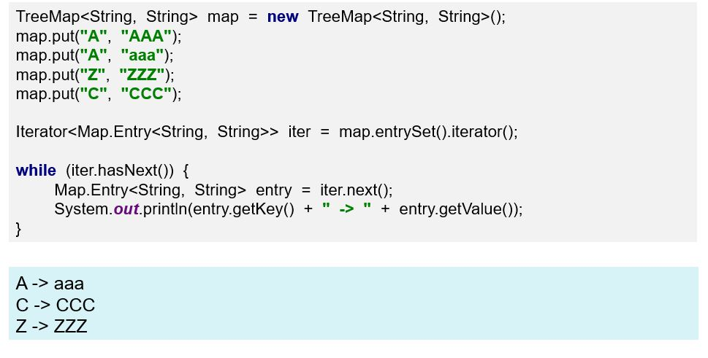
Maps: TreeMap

Slide 23
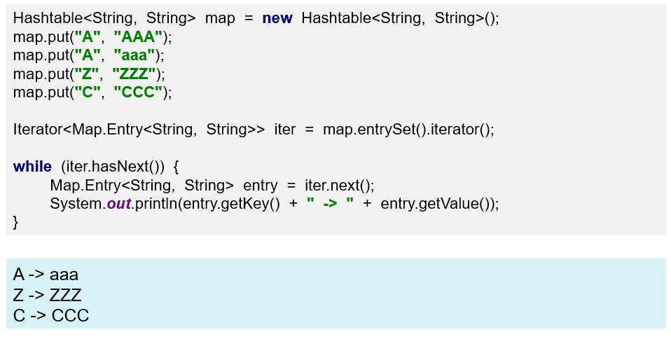
Maps: Hashtable

Slide 24
Typical operations with collections
Adding an element;
Extraction of the element
Removing an item;
Pass collection around;
Sorting the collection.

Slide 25
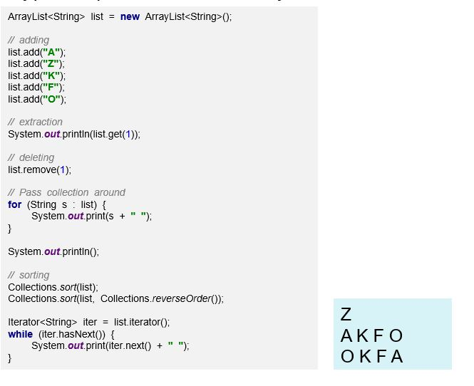
Typical operations with collections
Typical operations with ArrayList:

Slide 26
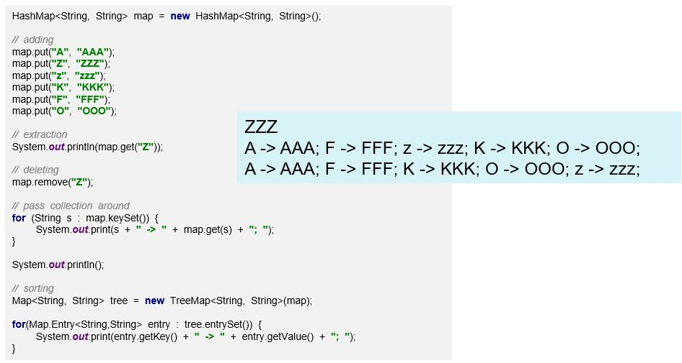
Typical operations with collections
Typical operations with HashMap:

Slide 27
References
"Collections", Java tutorial http://java.sun.com/docs/books/tutorial/collections/index.html
You can refer the demo code https://github.com/mstech66/javaBasic

Slide 28
Practice
1) Write java code to demonstrate usage of below collections framework class
a) ArrayList b) LinkedList c) HashMap d) LinkedHashMap e) HashSet f) LinkedHashSet g) TreeSet h) TreeMap
2) Write java code to demonstrate usage of custom class objects (example Student/Employee) in HashMap

Slide 29
Thank you

